Slide 1
Norway’s strategic challenges in a multipolar world
Ståle Ulriksen
Norwegian Naval College
&
The Norwegian Institute of International Affairs

Slide 2
Norwegian interests
Almost 60 % of Norwegian exports gas and oil
More than half the non-oil & gas exports rests on other maritime activities
In total, more than 80% of Norwegian exports are generated by activities at sea.
Norwegian commercial maritime activities are increasingly global in scope.
Norway depends upon the Sea and therefore
Norway has huge stakes in the world order!

Slide 3
World order
Multilateral
Multipolar
Strong inclusive international institutions
Competition based on rules and laws
Win-win often possible
Values and norms
Divisible power according to functions, fields
Importance of soft power
Predictable, transparent
Exclusive membership in Great Power concerts
Rivalry – balance of power
Zero-sum games
Indivisible power
Hard power, military very important
Frequent arms races
Contests of strength – war
Unpredictable

Slide 4
Drivers
Cooperation
Confrontation
Economic interdependence
Belief in win-win solutions
Acceptance of the view that only common efforts may solve common problems
Understanding of the potential devastating effects of modern war
Domestic unrest and power struggles
Thinking in zero-sum terms
Nationalism
Glorification of military might
Territorial ambitions
Resources
Fear

Slide 5
Fragmented, unstable multipolarity
Many poles, or Great Powers.
Loose and/or varying alliances
Constant positioning – moves and countermoves – zero sum games
Uncertainty created by rapid technological development.
Threat assessment cannot be made based on intent and capability alone
Situations will frequently arise where Powers may feel forced to act to prevent damage to their interests – or where they may see opportunities to promote their interests.

Slide 6
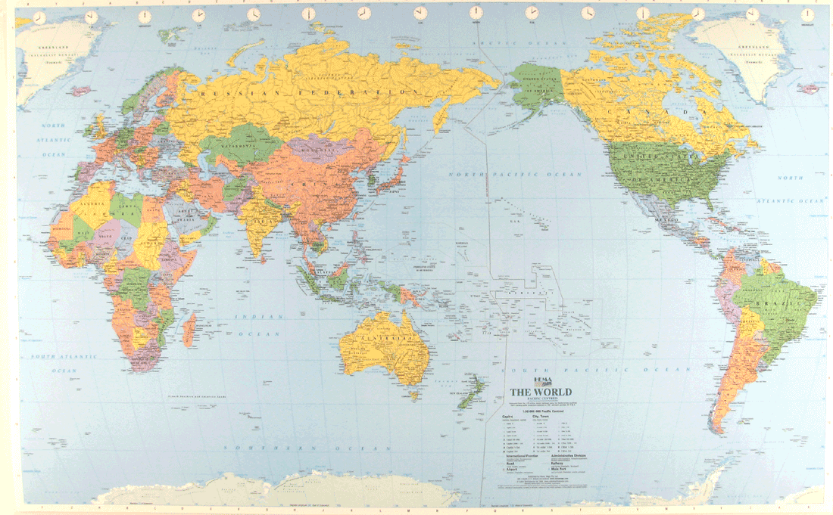
Pacific Century?

Slide 7
Global power dynamics
One global system
Many regional systems
I.e. global powers are more than regional powers, but not necessarily more powerful in the regions of the latter.
Global powers imply sea power, or an ability to project scalable military might across the high seas.
Global powers are able to strongly influence the rules of the world order.
The world order depends upon Sea Power!

Slide 8
Global worries
War between states, and between Great Powers, is more likely.
Simultaneously, “chaos conflicts” will continue, especially in the Middle East.
NATO’s military capabilities reduced.
Alliance solidarity questionable
The West appears weak, divided and confused.
Western values and interests threatened.

Slide 9
Norwegian worries
The armed forces are not calibrated for readiness or sudden crisis at home.
The armed forces has low endurance for sustained operations.
Large and rapid allied reinforcements not likely.
Svalbard (Fisheries Protection Zone) is an obvious vulnerability
Norwegian views on FPZ not shared by allies

Slide 10
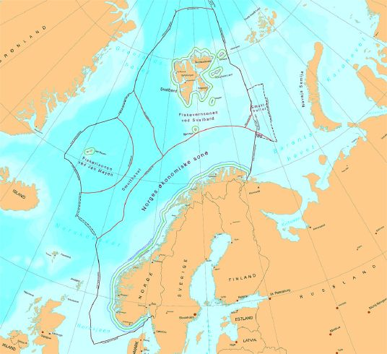

Slide 11
Norwegian needs
An ability to raise and continuously maintain a credible threshold against sabre rattling, gunboat diplomacy and military pressure against Norway.
An ability to generate sustainable fighting power rapidly at home.
An ability to receive and use such allied reinforcements that may arrive in an early phase.
An ability to contribute substantially and efficiently in support of the international system.

Slide 12
Sketch of a strategy
Very capable submarines – with at least one at sea at any time and several ready to go very quickly. VITAL INGREDIENT!
Active reserves – a modernized total defence system
Much more firepower and the ability to perform multidimensional sea denial operations.
Continued ability to support the alliance and the world order on both low end and high end missions.

Slide 13
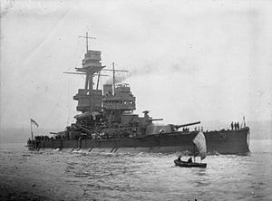

Slide 14
Supporting slides

Slide 15
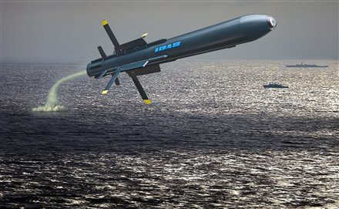

Slide 16
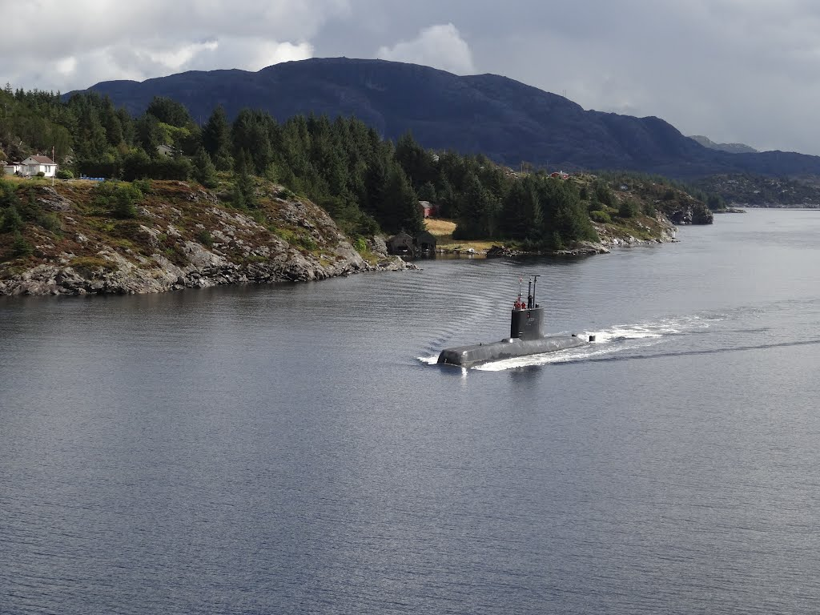

Slide 17
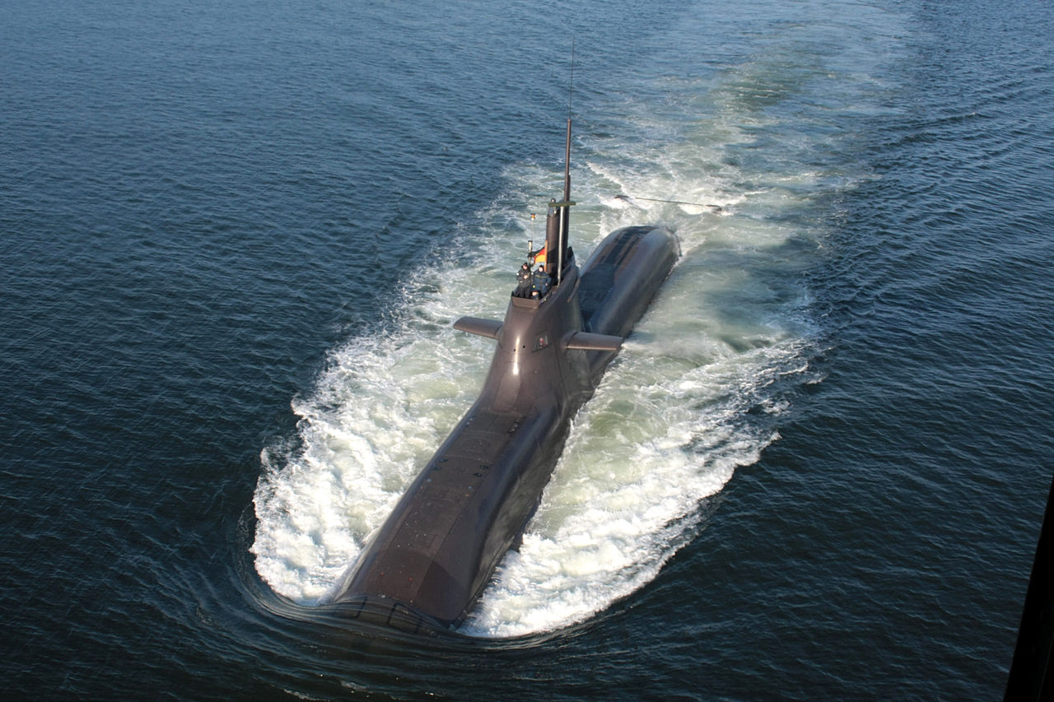

Slide 18
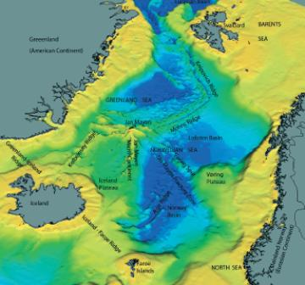

Slide 19
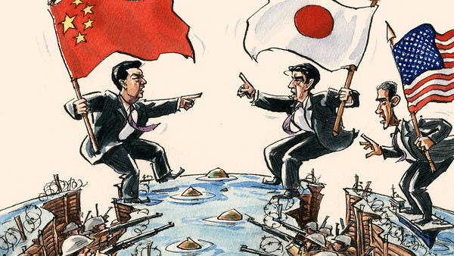

Slide 20
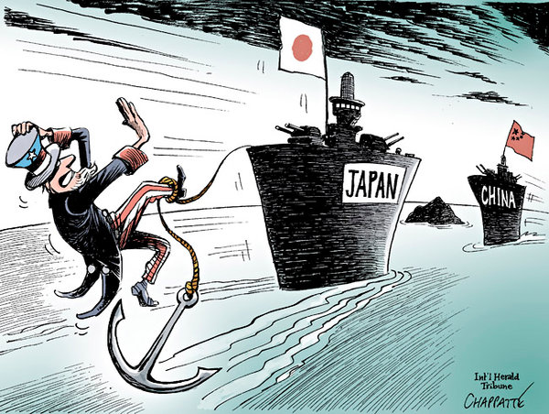

Slide 21
Deterrence
Reassurance
Cooperation

Slide 22
