Slide 1


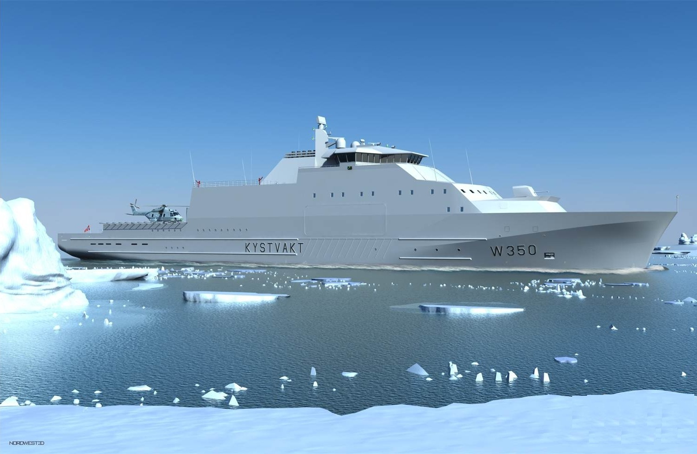
Coast Guard Program
New Vessels
Status and plans
Odd Magne Nilsen
Commander
NDLO NS
Coast Guard Projects

Slide 2
Norwegian Defence Logistics Organisation
Naval Systems
Materiel
investment
Contracting
Department
Project
Department
Frigate &
Auxiliary Ship
Projects
Coast Guard
Projects
Naval Special
Warfare
Projects
Mine Warfare
Projects
Corvette &
Naval Missile
Projects
School & SHG
Projects
Special Operation
Forces
Projects
Submarine
Projects
Department
Projects
Notes:
- Cost Guard Projects are organised as a section in the Project Department in NDLO Naval Systems

Slide 3
Coast Guard fleet today
Plans for HC carrying vessels
New vessels
Notes:
This presentation will have three main subjects….

Slide 4
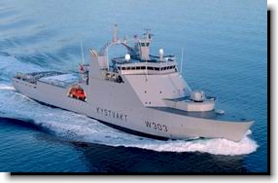
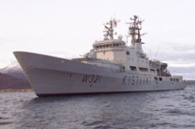
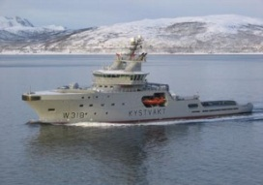
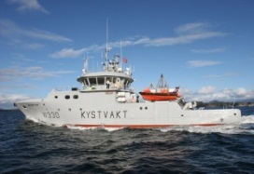
Owned Coast Guard Vessels
HC carrying vessels
KV Svalbard
Nordkapp class
KV Harstad
Nornen- class
Icebreaker
KV Nordkapp
KV Senja
KV Andenes
KV Nornen
KV Tor
KV Njord
KV Farm
KV Heimdal
In service since 2002
In service since 1981
In service since 2005
In service since 2007
Notes:
The Coast Guard fleet consist totally of 15 vessels, 10 owned and 5 leased vessels.

Slide 5
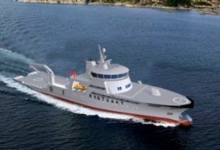
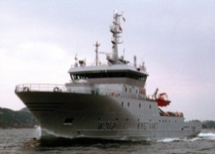
Leased Coast Guard Vessels
Barentshav class
KV Ålesund
Reine class
KV Barentshav
KV Bergen
KV Sortland
In service 2005-2008
Contract until 2025 - 2028
KV Magnus Lagabøte
contract until 2016
In CG service since 2012

Slide 6
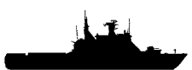




HC-carrying vessels
2014
2015
2016
2017
2018
2019
2020
2021
2022
2023
2024
KV Svalbard
MLU
3 x Nordkapp class
Upgrade
Tentative out of service from 2020
X
X
X
1 new HC-carrying vessel
Definition phase
Procurement phase
Tentative in service 2019
P6615 (1)
x new HC-carrying vessels
Conceptual phase
Definition phase
Procurement phase
Tentative in service after 2020
P3049 (x)
Notes:
The Coast Guard have been renewed during the last 10 – 12 years. The oldest Cost Guard vessels to day is the NKP Class, about 33 years old. The Coast Guard program will in the next decade have focus on HC-carrying vessels to ensure that there is a sufficient number of platforms to operate with NH90. Today we have 4 HC –carrying vessels, NKP class and KV Svalbard. Svalbard is the newest , in service since 2002 and the Coast Guard and NDLO have started planning for mid life update. The NKP class is approaching their end of life and the planning to replace them has started. On this slide you see the plan for this:
KV Svalbard: mid life update tentative 2018
NKP Class. There is ongoing activities to upgrade critical systems to extend lifetime until delivery of new vessels. Tentative replacement from 2020 by project P3049
P6615 New HC-carrying vessel. This project is in definition phase.
P3049 Replacement for NKP class. This project is in the conceptual phase and at present we assume that it will result with the same sets of requirements as in P6615. As far as we know, the discussion is more about the number of vessel then anything else.
Based on this assumption I will, in my presentation, focus on what we have done so far in P6615

Slide 7
P6615 New Coast Guard Vessel
Purpose
Acquiring a new helicopter-carrying vessel with ice capability in order to maintain the Coast Guard's capability with regard to organic helicopters.
The vessel shall be able to perform all operations in a safe manner up to and including sea state 5
Pending executive order (GO) from MoD
Notes:
- First the purpose of acquire a new vessel

Slide 8
Platform Capability requirements
Speed 22 knots
Ice strengthened
Sea-keeping (safe operations in SS5)
Diesel electric propulsion
Endurance 8 weeks (economic speed)
Accommodation for maximum 100 persons
Collective CBRN protection
Container capacity on deck
Towing capability
FRB (Sea Bear MK III)
Facilitate 2 boats for special purposes
Notes:
In the next few slides I will list the main capabilities from the requirement document:

Slide 9
Platform Capability requirements
Helicopter capability
  Landing aid for both day and night operations
  Deck (strength / space for AW101 size)
  Hangar (2 NH90)
  Service and maintenance facilities
Hospital facilities
Operation rooms arranged to support both military and civilian operations
  Oil pollution prevention capability
  Equipment for oil pollution prevention
  Oil spill storage capacity
  Assistance to Norwegian Coastal Administration
Notes:
Helicopter capability are based on Nato APP-2. Hangar and deck will be arranged for NH90 operations.
Hospital – Build with role 1 capability. The facilities will be arranged to be prepared for extended capability(Role2)

Slide 10
Military Capability requirements
Command Control and Information system (C2I)
  Including HC control
  Picture compiler
  Interface for Network based Defence (NbD)
Military communication systems (classified and unclassified)
  Radio systems
  SATCOM systems
  Link systems

Slide 11
Military Capability requirements
Armament
  Gun
  Gun fire support (all weather)
  Machine guns
Sonar
Echo sounder
Storage support for armed HC (torpedos and mines )

Slide 12
General regulations
Naval Ship Code (ANEP-77)
  ch IV, VI, VII og X
IMO/MARPOL 73/78
  Air pollution prevention
  Sea pollution prevention
NRAR:
  Structure
  Electrical systems
  Pre-treatment and painting
  Helicopter integration
  Habitability
Notes:
- We have some general rules and regulations to following when we shall design a new vessel.

Slide 13
Class notations (DNV GL)
1A1
NAVAL SUPPORT (stab)
NBC-2
HELDK-SHF(CAA-N)
ICE 1A*F
RPS+
NAUT-AW(ICS)
DYNPOS-AUTR
WINTERIZED POLAR(-30˚)
DEICE
E0
COMF V1C1
FIFI 1
OILREC
BWM-T
CLEAN-DESIGN
Notes:
1A1: Main character of class with construction symbol.
NAVAL SUPPORT (stab): Flying a naval flag and administered by a national naval administration with naval requirements to stability.
NBC-2: Requirments covring CBRN
HELDK-SHF(CAA-N): Helicopter landing area covering basic strength requirements. Additional requirements to ship safety(-S), helicopter safety(-H) and to helicopter facilities(-F). (CAA-N) means that the helicopter facility has been evaluated for additional requirements specified by the Norwegian Civil Aviation Authorities.
ICE 1A*F: High powered ships constructed according to Baltic ice rules.
RPS+: RP Redundant propulsion systems applicable to vessels where the propulsion system is of a redundant design such that at least 50% of the propulsion power can be restored after any single failure in the propulsion system, before the vessel has lost steering speed. RPS+ Redundant propulsion that in addition to RP cover failures, which are caused by fire and flooding incidents, before the vessel has lost steering speed.
NAUT-AW(ICS): Requirements to bridge design, instrumentation, location of equipment and bridge procedures with extended requirements to bridge design and instrumentation as well as automatic grounding avoidance system and information on the manoeuvring characteristics of the ship.
DYNPOS-AUTR (DP2): Dynamic positioning system with an independent joystick system back-up and a position reference back-up.
WINTERIZED POLAR(-30˚): Ships operating in cold climate environments for longer periods.
DEICE: De-icing or anti-icing systems.
E0: Instrumentation and automation installed to allow for unattended machinery space.
COMF V1C1: Comfort class covering requirements for noise, vibration and indoor climate.
FIFI 1: Vessels with special fire fighting capabilities. Active protection, giving it the capability to withstand higher heat radiation loads from external fires.
OILREC: Recovering and transportation of oil after a spill of oil in emergency situations.
BWM-T: Ballast water management system complying with the Ballast Water Convention (BWM/CONF/36). Ballast water treatment method.
CLEAN-DESIGN: Specifies additional design requirements for protection against accidents and for limiting their consequences.

Slide 14
P6615 Pre-procurement activities
Basic design
Model tests
Weight calculation
Technical specification
Station keeping analysis
Operability analysis
Armament analysis
Notes:
NDLO have started some pre-procurement activities that result in drawings an analysis. Several of this drawings and analysis will be a part of the Invitation to tender.

Slide 15
Basic Design
General arrangement (GA)
Design support activities
  Weight estimation
  Preliminary stability analysis
  Internal watertight integrity plan
  Speed-power estimation
  Profile and plan drawings
  Line plan
  Tank plan
  Mid-ship section
  Electrical load analysis
  Propulsion arrangement analysis

Slide 16
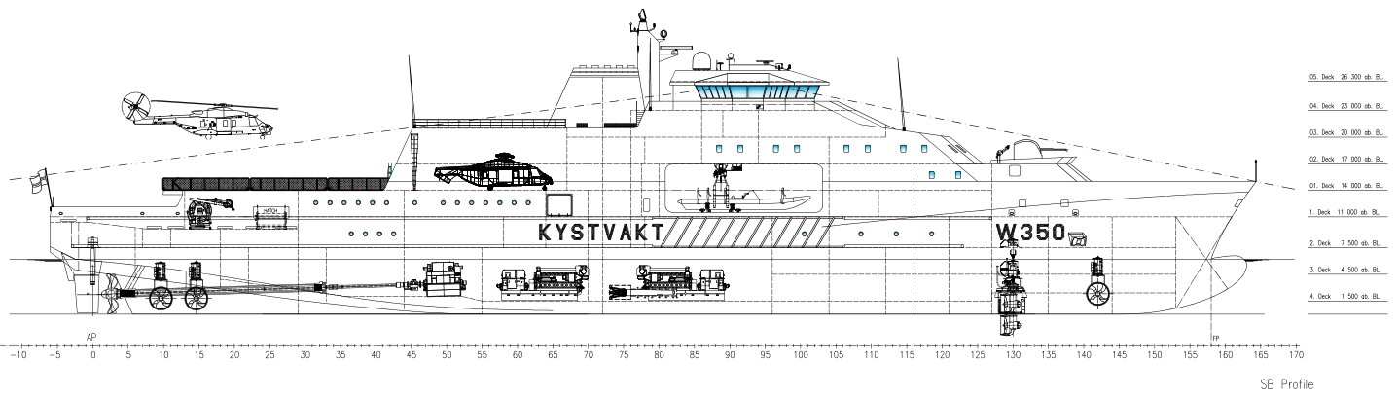
Main dimensions
Length over all(LOA): 136,40 m
Length betw. Perp.(LPP): 126,40 m
Breadth Moulded: 19,00 m
Draught at DWL: 6,20 m
Depth to 1. deck: 11,00 m
Light ship weight: 7.300 t
Dead Weight: 2.500 t
Displacement: 9.800 t
Steel Weight: 4.500 t
Notes:
We have done a basic design resulting in a functional General Arrangement. The design ensure that we have enough space to facilitate all capabilities and that the stability requirement are met.
The design result in the main dimensions…..

Slide 17
Notes:
The vessel is divided in main areas:
Bridge
Machinery space
HC deck and hangar
OPS rooms, radio room and instrument rooms
Space for Boat facilities
Hospital facilities
Mooring and main deck
Accommodation
Gun and magazine
Oil recovery area

Slide 18
Model tests at MARINTEK
Performance test
Sea keeping test
Notes:
Performance test: 22 knots in towing tank
Sea keeping test: Run with 14 knots , Head Sea , SSt 5, 3,25m significant Wave height, Wave period 9,7 s
It will be a requirement to the yard to also run ocean basin tests

Slide 19
Tentative schedule
Executive order from MoD Q4 - 2014
Pre-qualification Q2 - 2015
Invitation to tender Q3 - 2015
Negotiation Q1 - 2016
Yard contract Q4 - 2016
Production completed Q3 - 2019
Tests

Slide 20
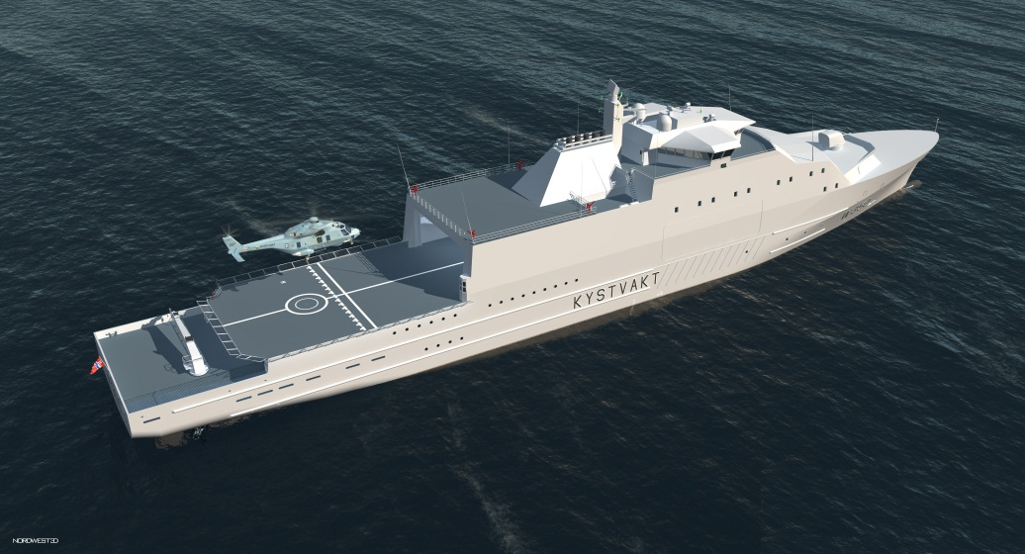
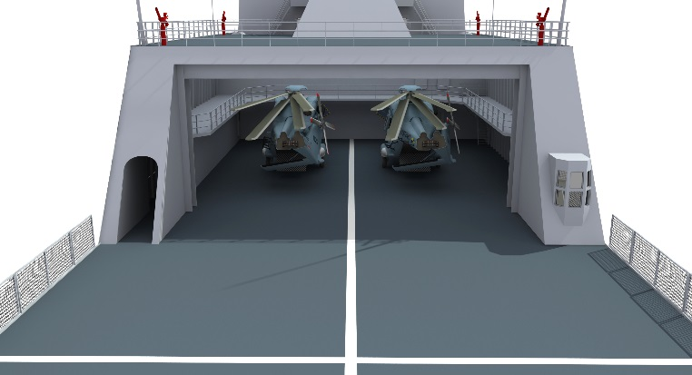
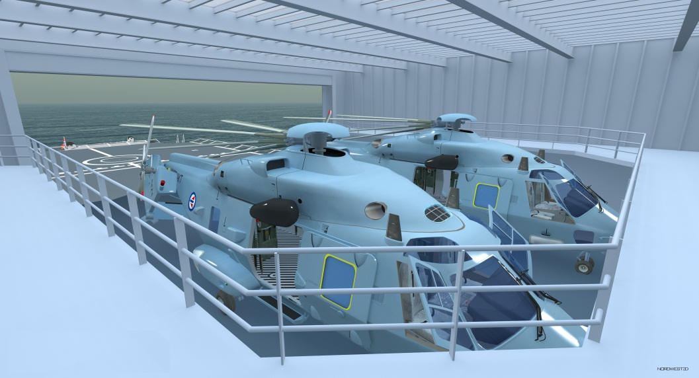
Helicopter facilities

Slide 21
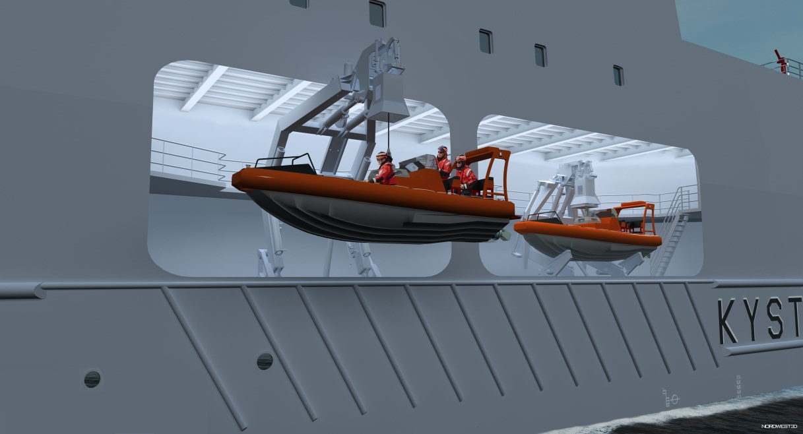
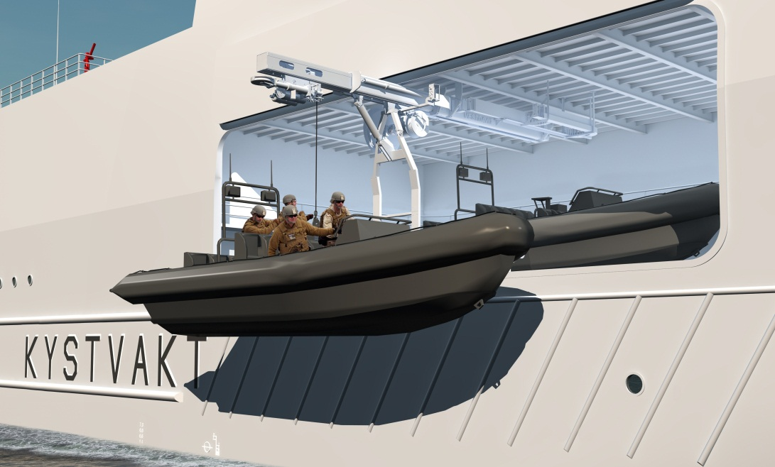
Boat facilities

Slide 22
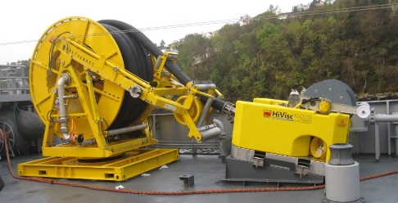
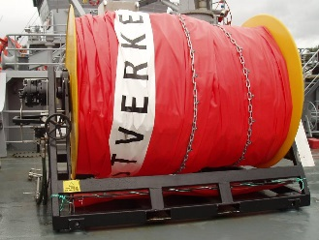
Environment pollution prevention
  Equipment delivered by Norwegian Coastal Administration
Notes:
- The vessel will be equipped with Trans Rec and oil boom.

Slide 23
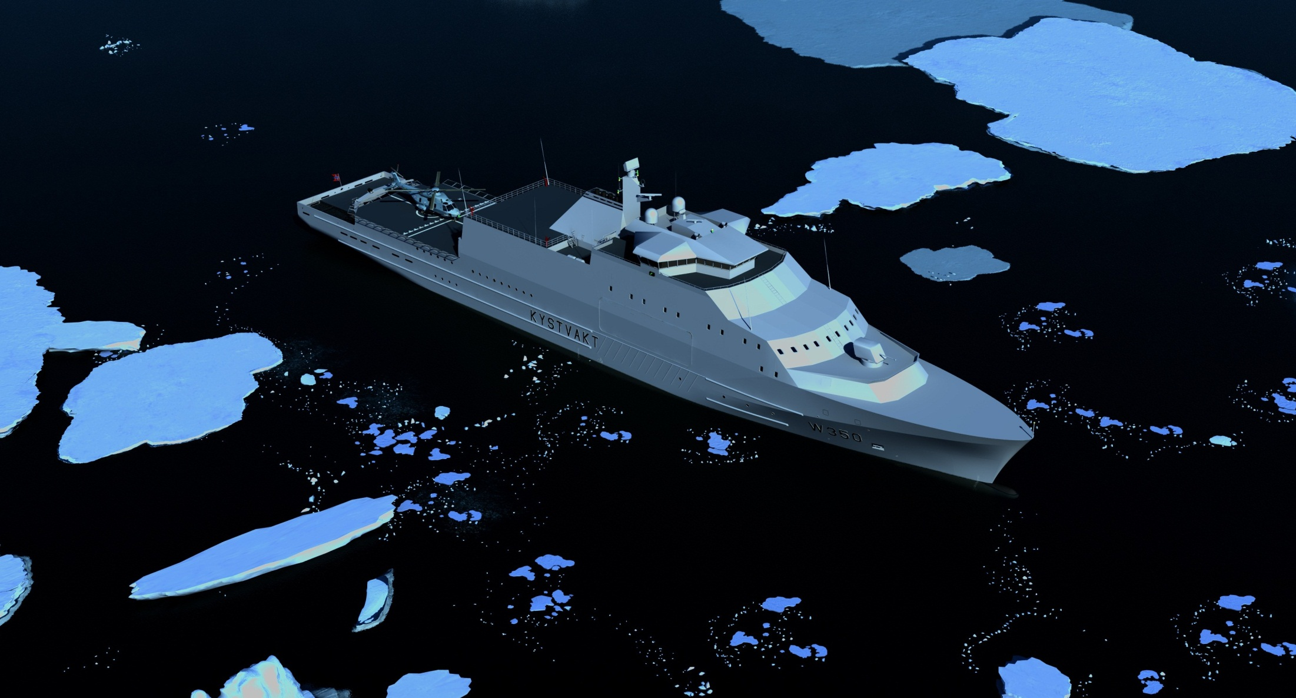
Notes:
We have some artist impression of the new vessel.

Slide 24
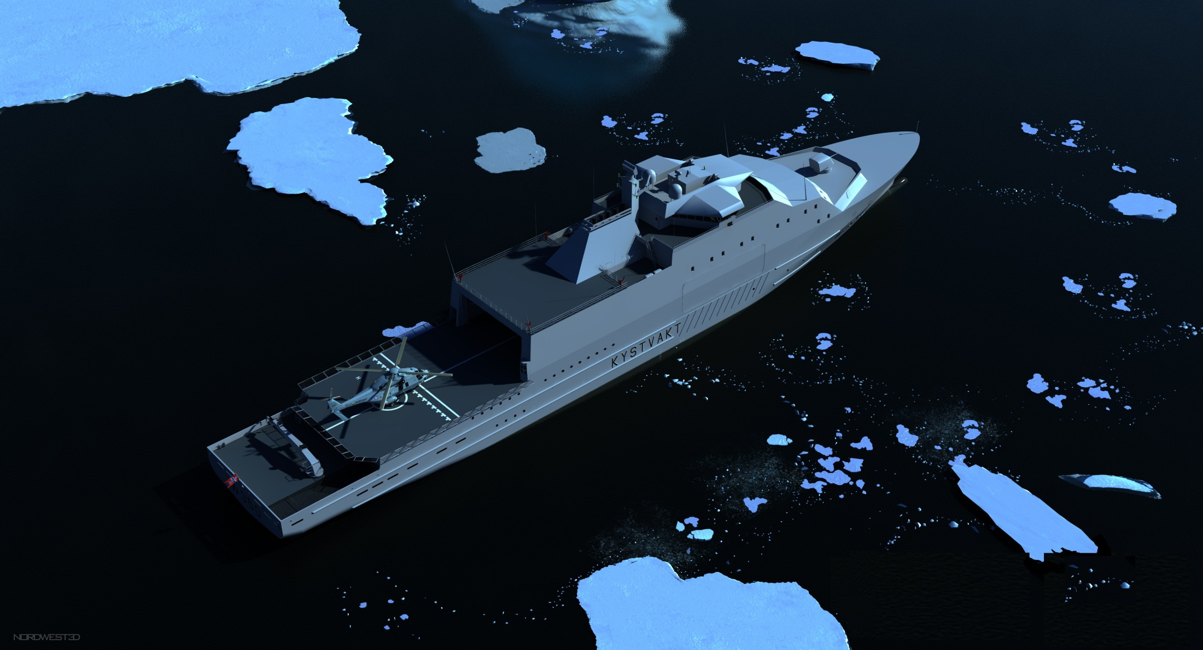

Slide 25
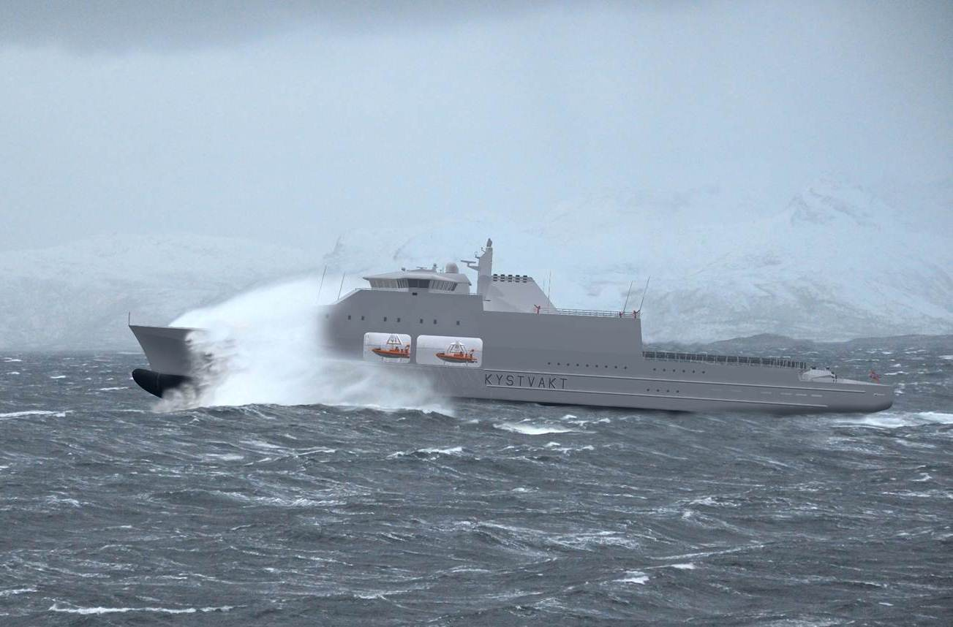

Slide 26
