Slide 1
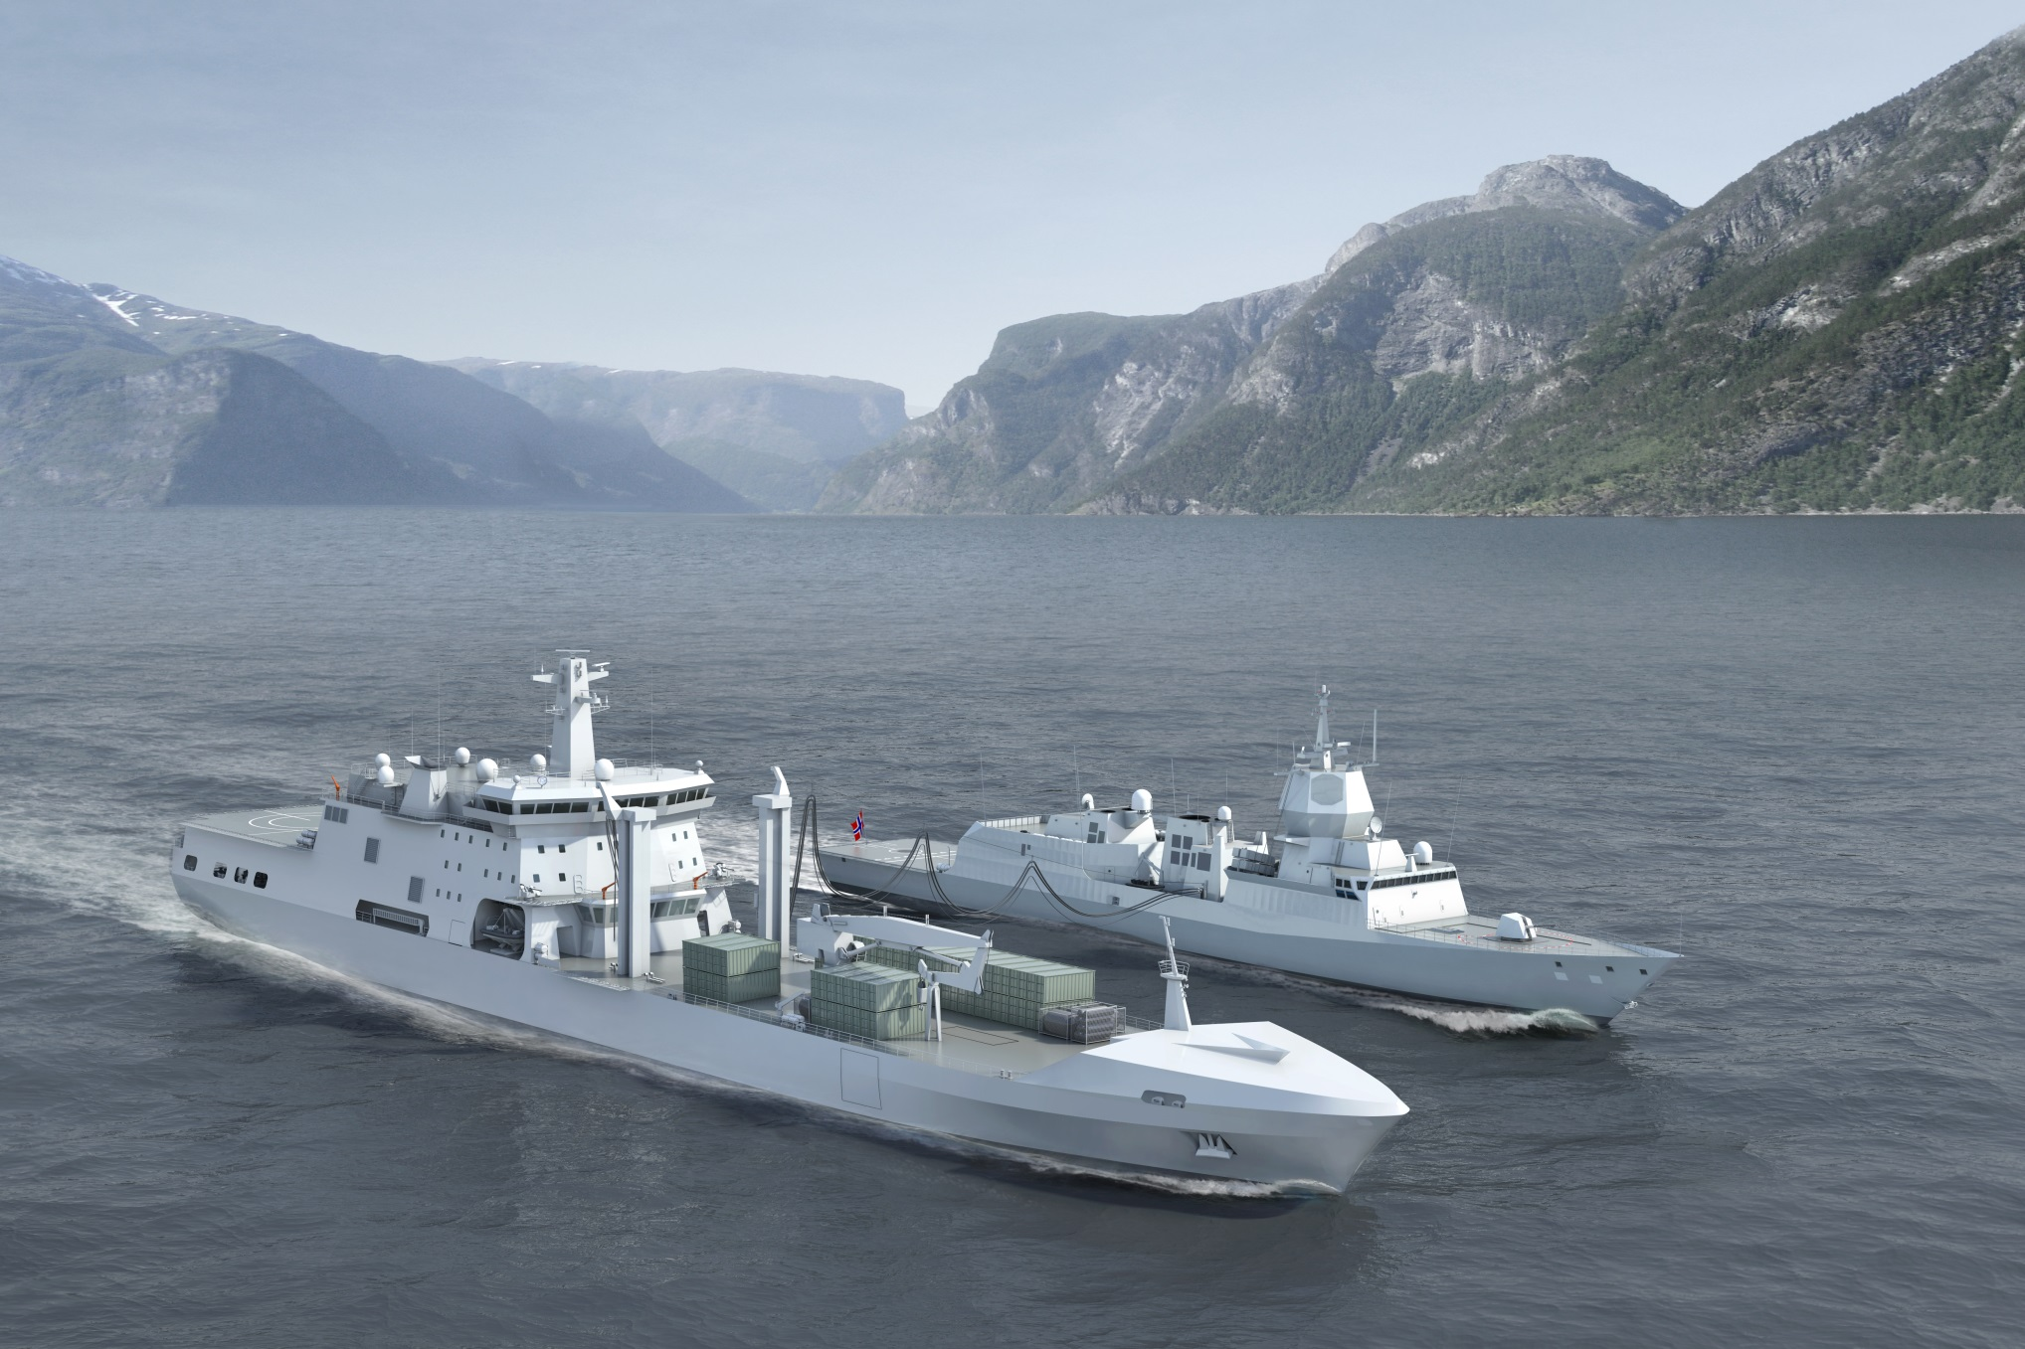
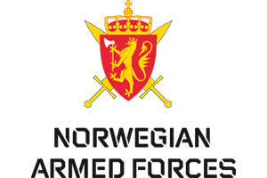
Logistics Support Vessel
HNoMS Maud
Sung Jin, Lee - DSME
Ian Wakeling - BMT
Notes:
Good afternoon
My name is Sung Jin, Lee in Naval Ship Marketing of DSME.
This is Mr. Ian Wakeling from BMT and he will support me if necessary.
We have been asked to end today’s presentations with a brief update on the Logistic Support Vessel His Norwegian Majesty’s Ship Maud. The largest ship ever built for the Norwegian Navy and one that will significantly enhance the navy’s capability to undertake and sustain global missions.
DSME and BMT are very proud to be delivering this important ship for the Norwegian Navy and are very grateful for this opportunity to brief you on a project that is well underway to deliver an excellent ship to time and cost.

Slide 2
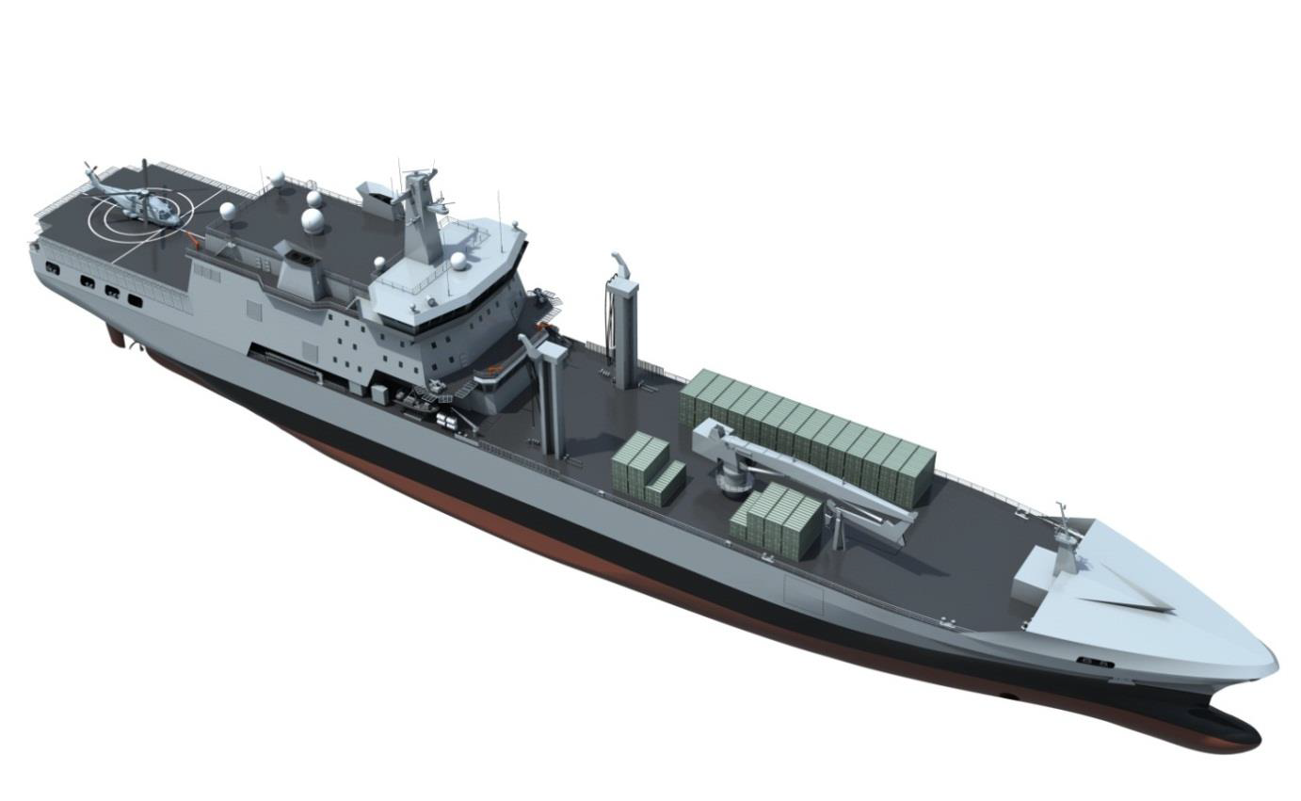
Contents
THE LSV Team
LSV Programme Status
Key Features of the LSV Design
      RAS
      Hospital
      Aviation
      Mother Ship
      C4l
      Hull Form and Propulsion
What Next?
Notes:
We will briefly introduce you to the team responsible for delivering the LSV and how we work together and then explain where we have got to in the programme and outline the future schedule.
As you are all interested in the Navy and ships we will give you a brief description of the ship that is being delivered with a focus on its key capabilities.
Finally we would like to give you a brief view of how we hope to build on this successful project both in working with the Norwegian Navy and supporting other navies around the world.

Slide 3
THE LSV Delivery Team
NDLO
CUSTOMER
CONTRACT AUTHORITY
Operational Need
Operational Environment
Engineering Experience
DSME
SHIPBUILDER
PRIME CONTRACTOR
Design
Overall Project Management
Production Efficiency
Test & Trial
Delivery
Warranty
ILS
BMT
BASIC DESIGN
SUB CONTRACTOR
Auxiliary, Warship and Submarine Design and Through-Life Support
ILS
Safety Management
Systems Engineering
UK MARS Experience
Notes:
The successful design, construction and delivery into service is being and will be delivered by joint working between the Norwegian Defence Logistics Organisation, DSME and BMT.
Although NDLO are the customer with DSME as the prime contractor and ship builder supported by BMT as design sub-contractor we see this as a joint team. Progress to date has greatly benefitted from this joint approach and we are sure that this will continue throughout the project.
In addition to defining the requirement and ensuring that we deliver what we are contracted to deliver, NDLO bring:
Understanding of the Operational need
Understanding of the Operational environment, in particular cold weather operations which has been of great value to us
Technical expertise and experience
DSME bring all the skills, expertise and efficiency of the largest shipbuilder in the world. As a prime contractor, DSME has a role delivering the best ship on time to our Customer, NDLO.
BMT is an Independent Engineering company with many years experience of the Design and Through Life Support of Warships, Submarines and Naval Auxiliaries. BMT’s role in the project is to deliver the basic design drawing on their expertise in such ships. BMT also provide Systems Engineering Management and Integrated Logistic Support services and undertook a safety and environmental analysis of the design as it developed over the last year.
BMT and DSME jointly bring experience of designing and building the MARS Tankers for the UK Navy which is and will continue to benefit the LSV project through lessons learnt and cooperation between Norwegian and UK Site Teams and crews in Korea.

Slide 4
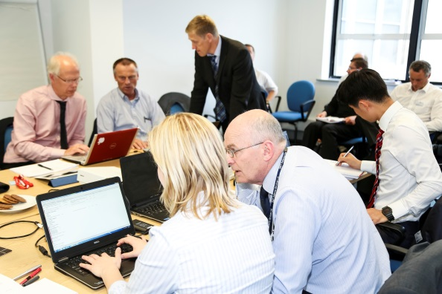
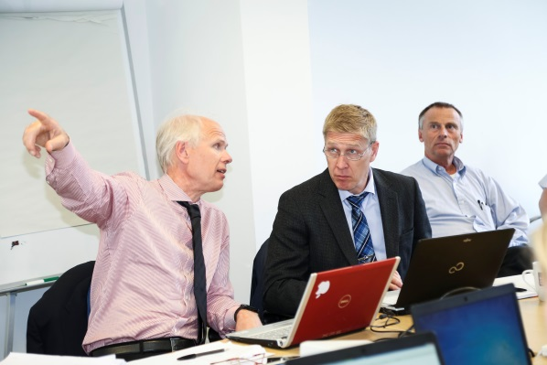
HOW WE WORK TOGETHER
CONTRACT:
What we will do
How we know its complete
PROCESSES & INFORMATION MANAGEMENT:
Helping us to do it
PARTNERING CHARTER:
How we will deliver
DDWG’s:
The way we did it
Notes:
We have and hope to continue working very well together so we thought a few words on how the team works might be of interest.
In addition to the contract that defines the formal relationships there is a Partnering Charter signed by all 3 parties that sets out how we wish to work together to resolve challenges and ensure that each party achieves their objectives from the project. This was developed based on a very frank and open discussions of our objectives and concerns.
A key part of the joint working has been the Detailed Design Working Groups. These groups are a contract requirement but have achieved far more than their defined objectives thanks to the pro-active participation of all parties. These meetings have provided opportunities for the experts from all 3 parties plus specialist sub-contractors, to get together and discuss the developing design. The development of mutual understanding of what lies behind some of the requirements, the challenges in meeting the requirements and the benefits of various design options has helped develop a really good design and significantly reduce the risk of future problems during acceptance of the ship. Of course we have had our challenges. Some have been quite significant, the electrical distribution system and HVAC design being two of the more significant. However all problems have been resolved to the satisfaction of all parties through open and constructive joint working, including major equipment sub-contractors.
I personally would just like to say that I think the way that Christian Irgens and his team have managed this project is an example of best practice. I hope that the successful approach followed for this project will help the delivery of the projects that we have heard about earlier today.
I would like to thank the NDLO project team for being so professional and constructive.

Slide 5
Programme Status
NEGOTIATION
CONTRACT
ITT2
6/7/12
PREFERRED BIDDER
20/3/13
C/A
28/6/13
DESIGN
C/A
28/6/13
IDR
7-11/10/13
PDR
6-16/5/14
CDR
13-24/4/15
BASIC DESIGN
DETAILED DESIGN
BUILD
S/C
14/4/15
Ist Block to Dock 28/9/15
Launch
19/12/15
DELIVER
30/9/16
SEA TRIALS 28/6 -8/8/16
PREP FOR SERVICE
12/16
3/17
GENERAL
MUSTER
12/17
DELIVERY VOYAGE
SEA TRIALS
WORK UP
Notes:
So where are we now?
As many of you will know the ITT was issued just over 2 years ago and after extensive and very productive clarification and negotiation a contract was signed at the end of June last year.
Since then Basic Design led by BMT has proceeded via an Initial Design Review to the Preliminary Design Review held last May.
Issues identified at PDR have now been resolved and we are in the process of finalising agreement of the new design baseline.
DSME have commenced Detailed Design which will culminate in the Critical Design Review in April next year.
DSME will cut steel around the same time. This date was recently brought forward following the success of PDR and a joint review of the programme. The first block will be placed in the build dock just over a year from now in September 2015.
3 months later the ship will be floated out of the dock for final outfitting ready for Sea Trials in July 2016
The ship will be delivered to the Norwegian Navy in in 2 years time in September 2016 just over 3 years after tenders were invited.
We understand that the ship will spend another month at a Korean Naval base for crew work up before sailing for home. The voyage home will take 6 to 8 weeks.
Final Sea Acceptance Trials including Replenishment at Sea with Norwegian Navy Ships and Helicopter operations will take place at the beginning of 2017
This will be followed by work up, FOST in UK and some exercises before General Muster at the end of 2017 and full entry into service in January 2018.

Slide 6
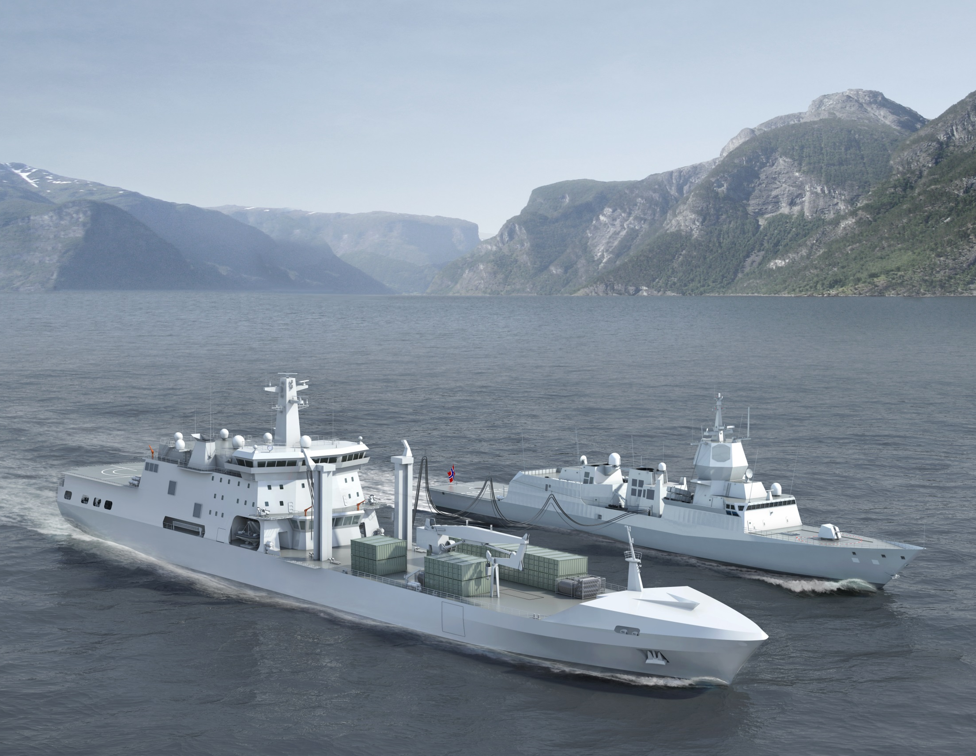
Length overall 180.7 m
Beam: 25.9 m
Design draught 8.6 m
Speed 18 knots
Primary fluid cargo capacities:
DFM F76: 7000 te / AVCAT F44: 300 te
Primary solid cargo capacities:
40x TEU / 200 te ammunition or a mix of vehicles and boats.
Dual abeam RAS rigs and stern reel
25 tonne SWL deck crane
Side ramp
Flight deck and hangar for organic NH90 (stowage for 2 x NH90)
Large medical complex
LSV Capabilities and Particulars
Highly Flexible Multirole Vessel
Replenishment at Sea: DFM F76, AVCAT F44, Fresh Water, Stores, Ammunition,
Support Ship for Norwegian Task Force: Nansen class frigate, Skjold-class corvettes, Mine countermeasure vessels, Ula-class submarine, Small craft (CB-90)
Humanitarian Relief: hospital, containers
Helicopter Operations
Command Platform
Military Support
Notes:
So what does Maude look like and what can she do for the Norwegian Navy
Many of you will have seen this slide before.
She is a highly flexible multi role vessel which will almost certainly find itself doing missions that have not yet been thought of.
She is designed to provide liquid and solid replenishment at sea and act as a support ship for the Norwegian Task Force.
She has a large hospital and capacity to carry a wide range of cargo in containers for humanitarian relief or other missions
She provides a valuable helicopter operating base and command platform and the cargo capacity, which could include vehicles and boats, and the large crane enables her to support a wide range of military operations
Key cargo capacities are 7000te of Dieso, 300 te of Aviation Fuel, 200te of ammunition of various sorts from missiles and torpedoes to bullets and she can carry 40 containers.

Slide 7
LSV Arrangement
Notes:
This slide gives you an idea of how the ship is arranged.
The flight deck and triage area are on the same deck and above the hospital. Cargo tanks are amidship with the RAS rig. The cargo magazine is well forward with the stores with the heavy lift crane covering the containers.
There is a side ramp forward for use when loading and unloading stores or casualties.

Slide 8
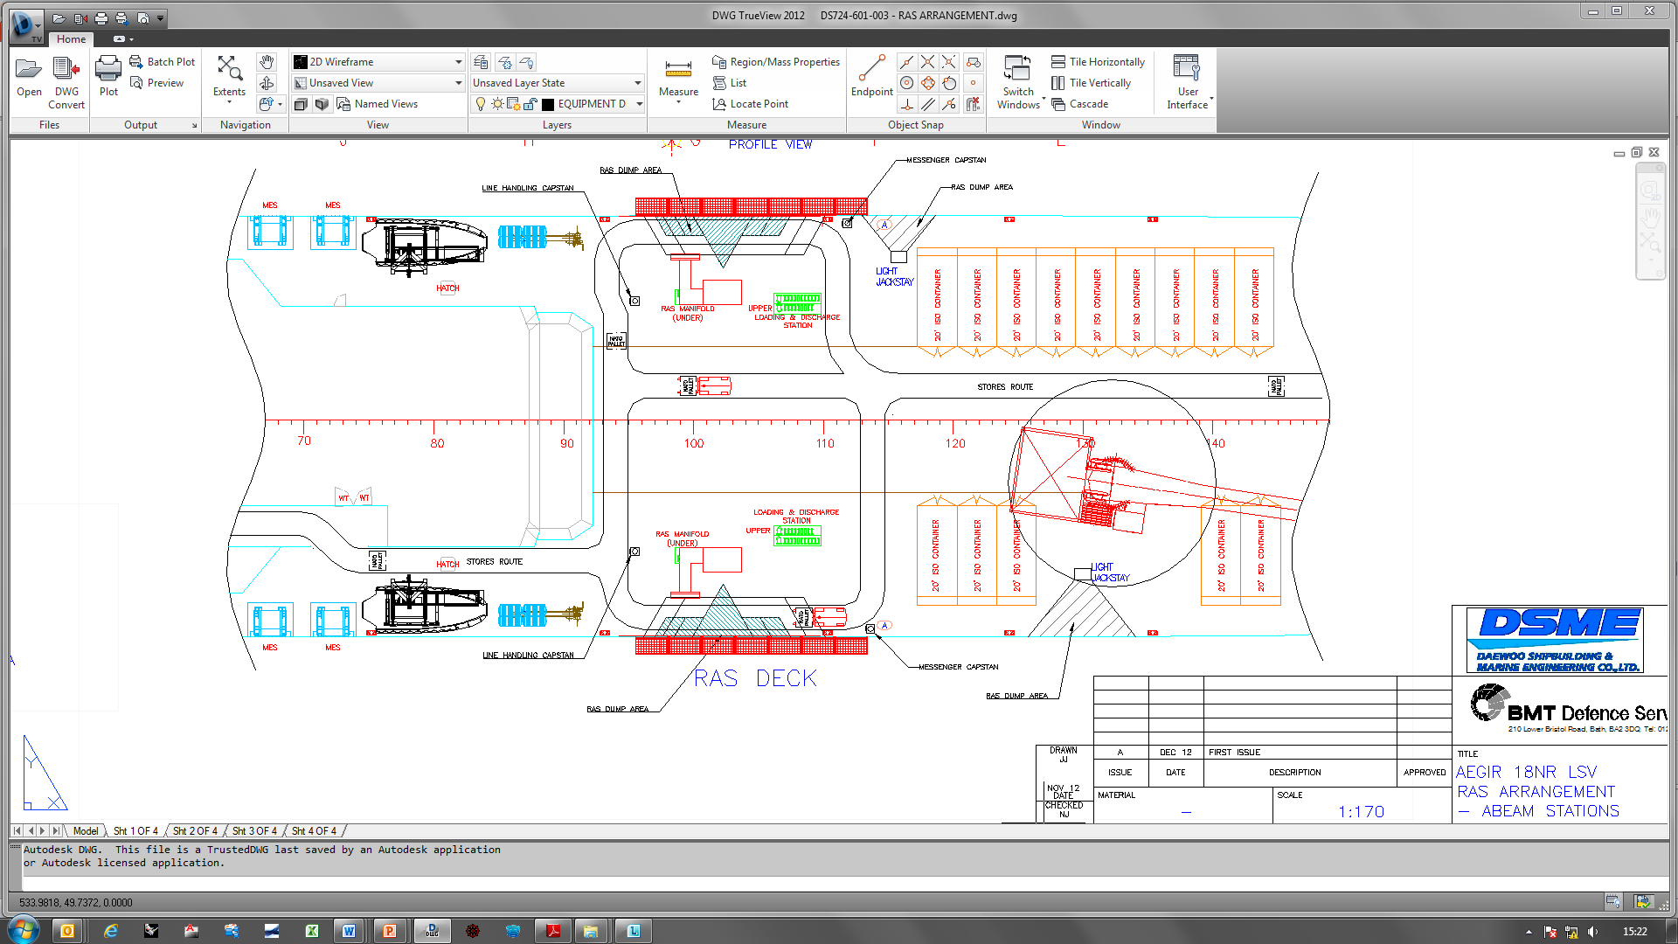
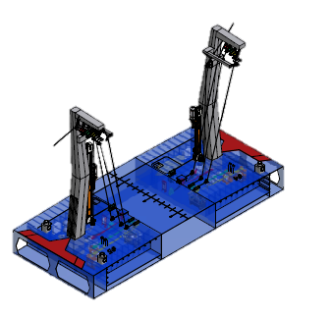
RAS Arrangement & Cargo Handling
Key Information:
Two abeam stations
Clear stores routes
Below deck equipment
Anti-icing
RAS ready room
Refrigeration container for perishable cargo
Notes:
The ship has 2 RexRoth RAS rigs and is arranged for clear movement of cargo from the stores forward to the RAS positions and on aft for VERTREP.
Almost all RAS rig equipment is below decks for protection and the RAS area and equipment are fully covered by de-icing systems.

Slide 9
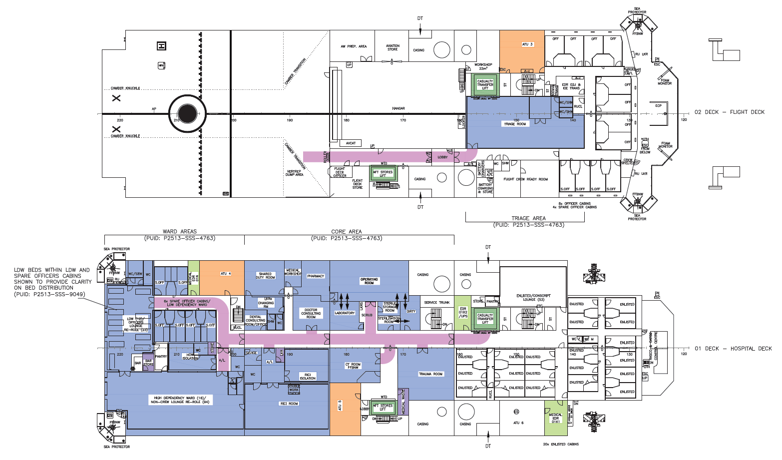
Hospital Arrangements
Notes:
The hospital has been subject to a lot of design effort working with Norwegian users and experts and our specialist sub-contractor SAAB Medical.
The aft end is dual role. During normal operations it is the officers and non-crew lounge and spare officers cabins.
When needed the non crew lounge converts to become the HIGH Dependency Ward. All beds and equipment are stored ready behind screens in the lounge. The Officers Lounge and cabins become the low dependency ward.
As mentioned before the hospital is designed for easy flow of patients from flight deck to Triage room. From there they descend by lift to the trauma, operating or CT room before moving to resuscitation and intensive care or the wards. There is also access to the lift from the main deck where there is also a de-compression chamber and access to the ship’s boats and side ramp

Slide 10
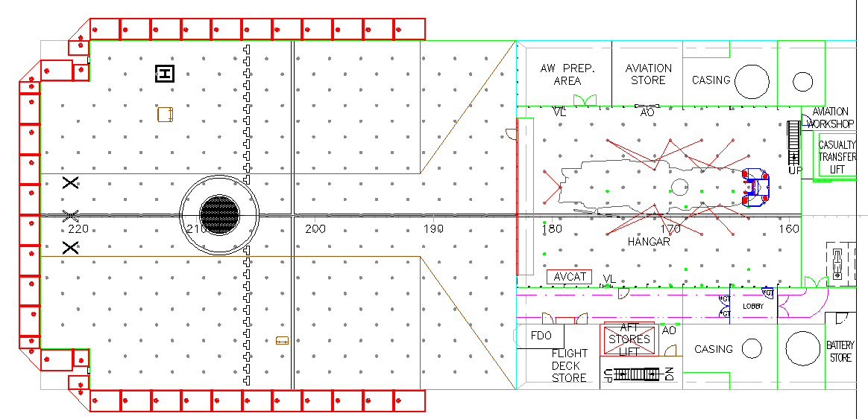
Aviation
Key Information:
Large flight deck to accommodate NH90, EH-101 Merlin and CH53 Sea Stallion
Hangar for level 2 maintenance of one NH90 or stowage of one operational and one spare NH90.
Good access to triage area / medical lift and stores lift
Notes:
The flight deck is designed to operate NH90, Merlin or Sea Stallion helicopters.
A large hangar is provided which can either provide full level 2 maintenance for an NH90 or provide stowage for one operational and one spare helicopter.

Slide 11
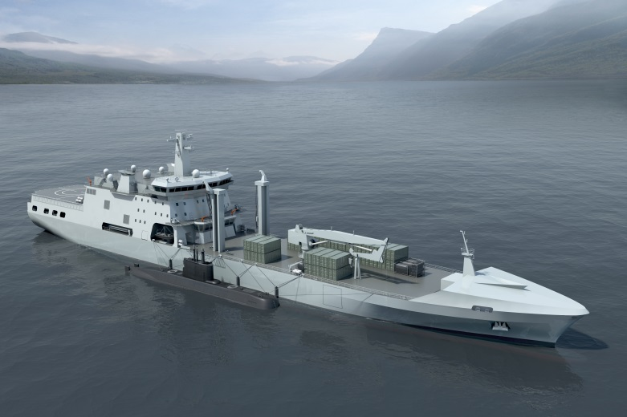
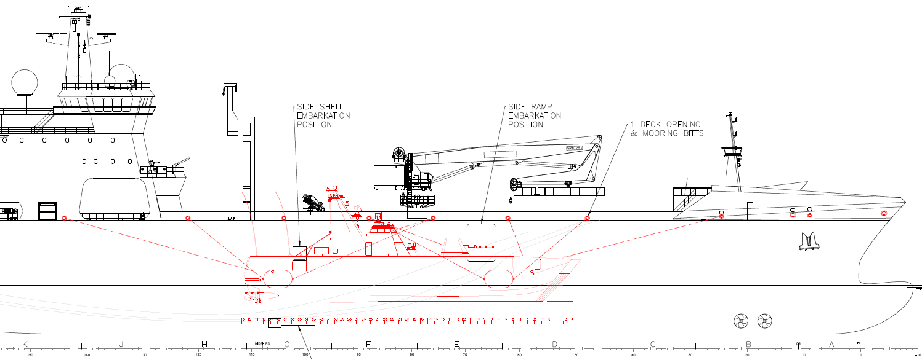
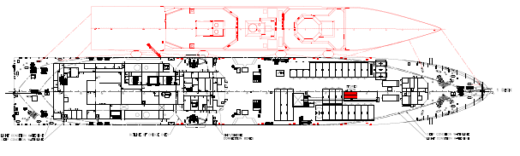
Mother Ship
Key Information:
Mooring for vessels and submarines
alongside
Side Access Doors
Support cranes for replenishment
Hose and Power Connections
Support for Crews inc. Catering, Gym and Sauna
Notes:
The ship has been carefully designed for her mother ship role with mooring and fendering arrangements for submarines, small craft and frigates etc.
The pilot door provides easy access and the small support cranes and main ship’s crane enable replenishment and maintenance. Connections are provided for power and fluid transfers including offloading sewage.
Internally the ship has facilities for supporting boat crews including catering which can provide pre-prepared meals, a gym and sauna.

Slide 12
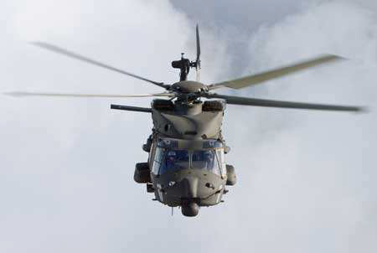
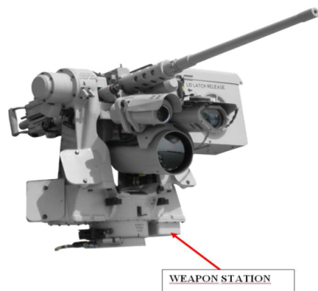
Integrated Weapon System
Key Information:
Navigation – Integrated Bridge (IBS)
    Full suite
Command & Control Systems
    ECDIS / AIS
    Autopilot
Sensors
    Radars X/S Band and IFF
    Optical Bearing Device (OBD)
    Infra Red Camera
    Log
Integrated Communications System (ICS)
    External Communications
        Strategic HF & MILSAT
        Tactical V/UHF
        Civil GMDSS
        Security
    Internal Communications
    Information Systems
Operations Room
Helicopter Control
    Helo Approach Radar
    Landing Aids
Weapons & Countermeasures
    4 x Sea Protector (Future Installation)
    Small Arms
  Integrated Platform Management System (IPMS)
    Damage Control
Notes:
The IWS for Maude includes a comprehensive communications system and capacity within the Ops room for future expansion of systems
The ship is being built to allow for future fit of 4 Sea Protector guns.

Slide 13
Hybrid Power and Propulsion Solution
Combined Diesel Electric or Diesel (CODLOD) – Flexible Operation, Low Life Cycle Cost
Hybrid Electrical Machine
Alternator: 2400kWe at swbd
Motor : 1000kWb on shaft
3,170kWe Genset
Gearbox
Main Diesel Engine
7,500kWb
Main Diesel Engine
7,500kWb
3,170kWe Genset
Hybrid Electrical Machine
Alternator: 2,400kWe at swbd
Motor : 1,000kWb on shaft
Notes:
A key feature of the AEGIR Support Ship family of designs is the Hybrid Power and Propulsion System. This is a Combined Diesel Electric or Diesel (CODLOD) System which provides for a high degree of flexibility in operation to match the wide range of modes and environments within which the ship must operate. This flexibility provides significantly lower life cycle cost than alternative arrangements by minimising the time that the main engines and generators operate at inefficient loadings and reducing running hours of all machines.
The following slides show some of the operating modes.

Slide 14
Modes of Operation: Transit (Electric)
Operation below 8 knots
DG
Gearbox
PTI /
PTO
690V Swbd
Main Diesel Engine
Bow
Thrust.
Gearbox
Main Diesel Engine
690V Swbd
PTI /
PTO
DG
Notes:
Pure Electric Drive for slow speed with the generators providing ship and propulsion power

Slide 15
Modes of Operation: RAS Operations
Operation between 10 and 16 knots
One Shaft Generator operation as standby
DG
Gearbox
PTI /
PTO
690V Swbd
Main Diesel Engine
Bow
Trust.
Gearbox
Main Diesel Engine
690V Swbd
PTI /
PTO
(Standby)
DG
Notes:
The most demanding mode. RAS. Where Main Engines and Generators are needed with the Main Engines providing some power for ship’ systems.

Slide 16


Modes of Operation: Transit ME
Operation between 9 and 18 knots
Main DG sets available to provide additional power if required
DG
Gearbox
PTI /
PTO
690V Swbd
Main Diesel Engine
Bow
Trust.
Gearbox
Main Diesel Engine
690V Swbd
PTI /
PTO
DG
Notes:
During normal cruise the main engines provide all the power with electrical power provided by the hybrid machines operating as generators
As you see a very flexible and efficient system

Slide 17
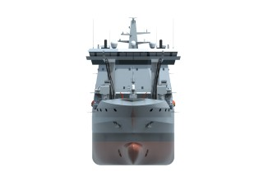

What Next for LSV?
Detailed Design
Build
Inspection, Tests and Trials
Delivery
Warranty – With Support
In Service Technical Support
        Design Management
        Equipment Management
        Maintenance Management
        Spares Management
        Safety Analysis
Notes:
So that is Maude. Where do we go next
As mentioned at the beginning Detailed Design is underway leading to construction starting in April next year with Sea Trials in July 2016 and Delivery in September 2016
The ship will be under warranty for the following 12 months with DSME providing a comprehensive service to ensure that any faults are fixed promptly to avoid disruption to the trials and training programme.
As part of the contract we are also required to submit a Technical Support Plan identifying the services that we can offer through life. This will be a topic of discussion over future months as part of the development of the Integrated Logistic Support package which aims to help the Norwegian Navy maximise operational benefit and availability of Maude through life while ensuring the maintenance of a safe vessel with low through life costs.

Slide 18
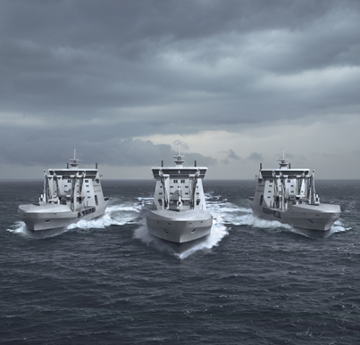
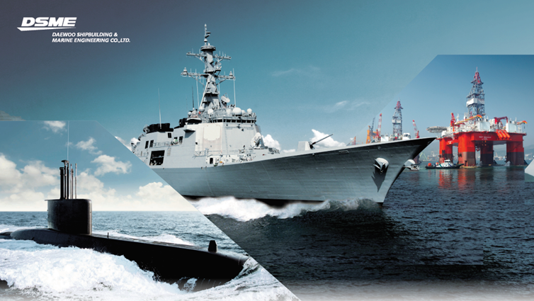
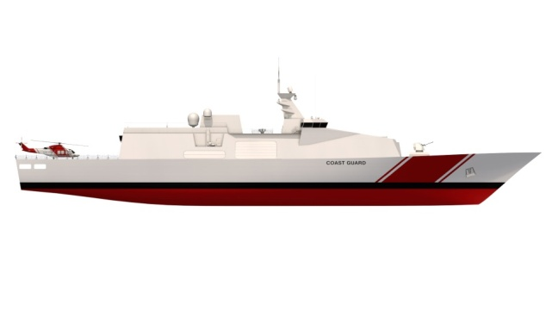
What Next for DSME
The Next Auxiliary Project
      Modified Design for Australia
      New Zealand
      Other Countries
Combatant and Non-combatant Ships
Submarines
In Service Support
Patrol Vessel – BMT design
Notes:
Finally we thought you might be interested in how we in DSME and BMT will take the lessons we are learning from this project forward in future work.
Based on the success of the UK MARS Programme and the Norwegian LSV Project and we have been invited to work with the Australian Navy to identify what changes may be required to the LSV design to meet their requirements.
We are also expecting to be invited to tender for a similar vessel for New Zealand and there are other countries like India, Singapore, Brazil with requirements for new auxiliaries
DSME has extensive experience in designing and building various kind of Combatant and non combatant ships for the Korean and other navies and BMT also has a generic patrol vessel design.
DSME has had a technical dialogue for Norwegian new submarine project following its RFI last year.
Finally. In support of such major projects we also seek opportunities to combine our experience of providing in service support services to the RN with our knowledge of the ship design and working with customers to help customers achieve the best through life value from the ships we have delivered.

Slide 19
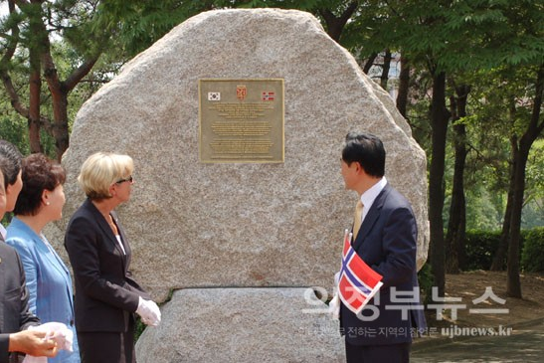
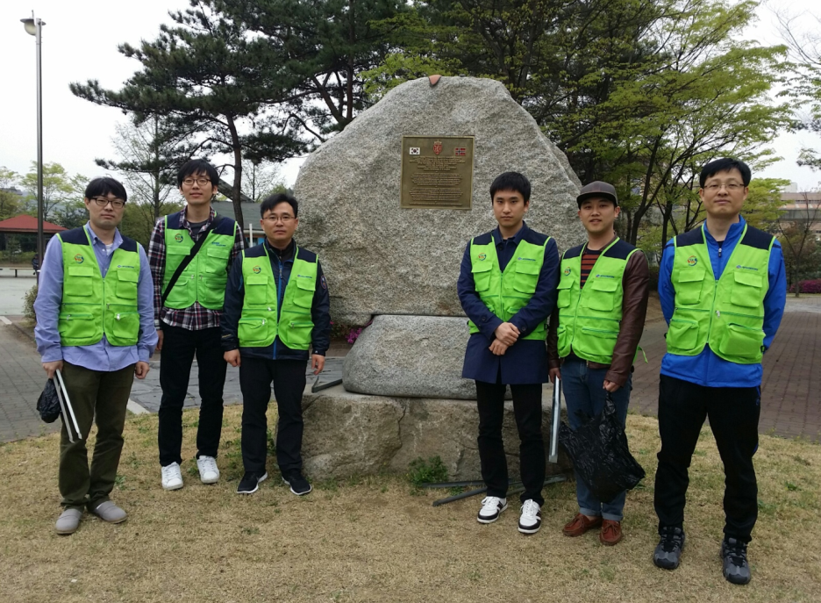
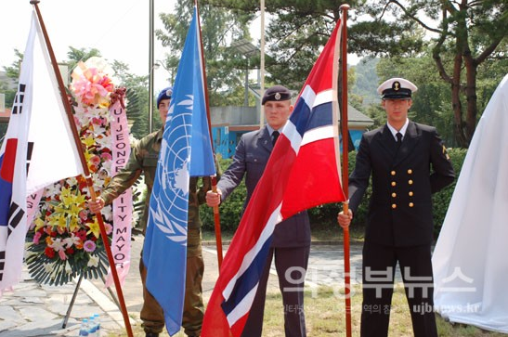
Thank you !!
Notes:
Thank you. I hope you have found this presentation to be an interesting end to the day. We are of course very happy to answer any questions you may have now or later during the social event this evening.

