Slide 1
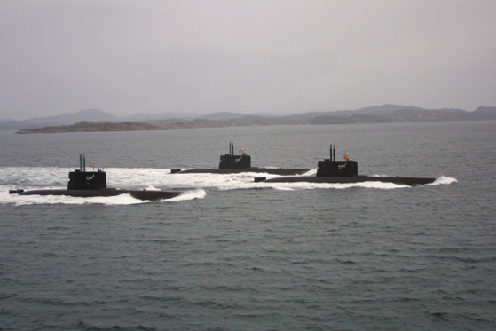
Submarine capability beyond 2020
Norwegian Ministry of Defence
Ulvik, August 27th 2014
Audun Halvorsen, Political Advisor to the Minister of Defence
Notes:
<Personal introduction>
1

Slide 2
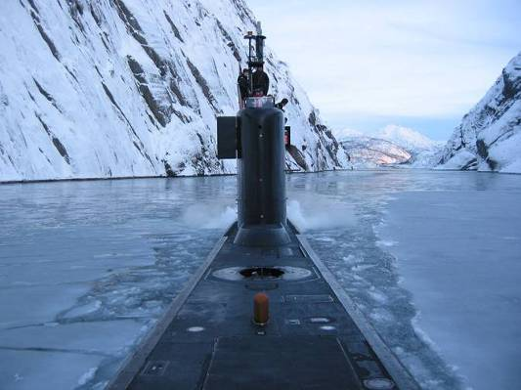
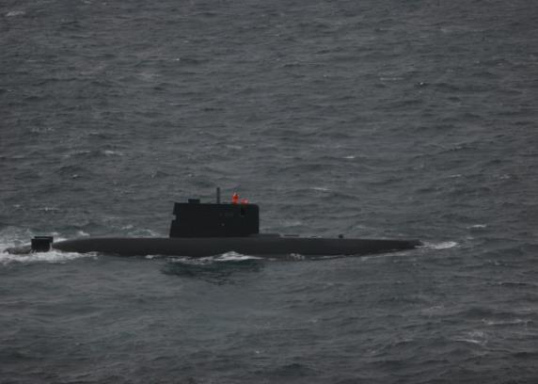
Notes:
<THE STRATEGIC PICTURE>

Slide 3
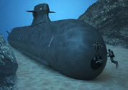
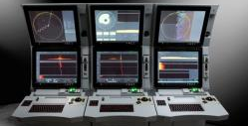
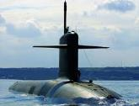
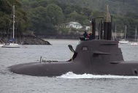
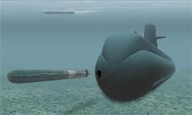
Submarine capability beyond 2020
Background information
Conceptual studies; alternative solutions
Current project status and plan for the next phase
Political considerations
Notes:
<STATUS AND FUTURE PLANS>

Slide 4
Background information
A Service Life Extension Program or procurement of new submarines will be required in order to maintain a submarine capability when the Ula-class reaches the end of its service life.
Conceptual studies have been conducted since 2007 in two phases, identifying, studying and evaluating alternative solutions.
The project is named P6346 Submarine capability beyond 2020.
Notes:
4
<BACKGROUND INFORMATION>

Slide 5
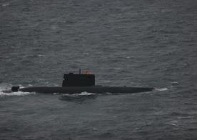
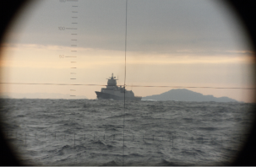
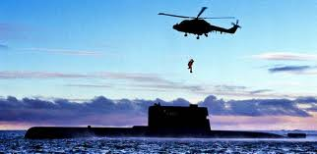
Project 6346 – conceptual study phase
Produce a basis for the Government’s decision between a Service Life Extention Program (SLEP) for the Ula-class and procurement of new submarines
Milestones:
Ultimo 2014: Presentation of the recommendation to the government
2014-2016: Project definition phase; produce a procurement plan
Within 2017: Government, and then Parliament, make an investment decision

Slide 6
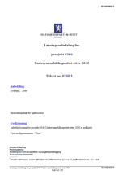
Utredningen i denne fasen
New submarines
Life extension
Annexes and appendixes
Main document
Notes:
6
<STATUS>

Slide 7
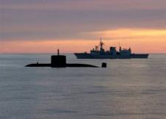
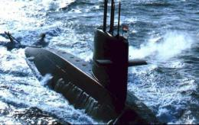
Political considerations
«The submarine is a key capability in a modern defence force.» (Parliamentary proposition 73 S – White paper 2012)
Norway is a maritime nation. Maintaining a credible deterrent in the maritime domain is important for a small nation with significant ocean areas, a long coastline and huge economic interest in maritime industries.
Life Cycle Cost (LCC)
The future structure of the Armed Forces
International cooperation – finding a partner(s)
Norwegian defence industrial interests
Notes:
7
<POLITICAL CONSIDERATIONS>

Slide 8
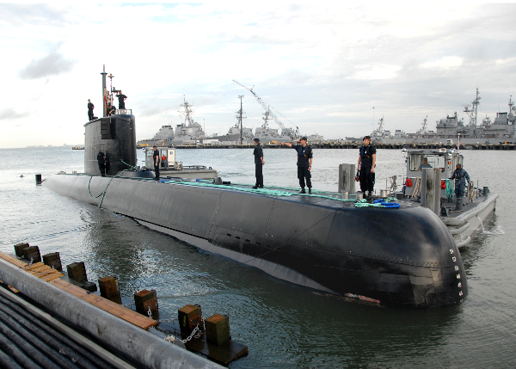
Summary and conclusion
Norwegian Ministry of Defence
Project 6346 is on schedule in producing a basis for the decision between SLEP and new submarines
A recommendation will be presented to the government in 2014
A project definition phase will start in 2014, and the plan is to present the Parliament with an investment project within 2017
Notes:
<SUMMARY>

